Slide 1

TERNSHIP 2024
SAJAL SINGHAL

Slide 2
Customer Support Portal
It is an internal tool/Platform that provides a single view of a customer for GSO(Global Sales Organization) and GCO(Global Customer Operation Teams) users to manage customer information, contracts, billing, and provisioning.

Slide 3
Timeline
Onboarding
Kickstarting the brainstorming on the Onboarding Tasks, Multiproduct, Tech
Week 1 - Week 3
Product Utilization Chart
Build Product Utilization Chart feature, Ramped in Prod
Week 3 - Week 5
Multi-Dashboard Phase 2
Build components and features for fulfillment page UI to fulfill requirements
Week 5 - Week 12
Future aspects
Complete bulk allocation grid, compatibility checks, revoke and grant selected actions, and stylings as per the designs

Slide 4
OnBoarded with Acceptance Tests
Problem Statement
Missing acceptance tests for following high traffic pages on CSP
Fulfillment Page
Order Page
Finance-contract Page
Why it is Required?
To check cross compatibility of components
End-to-End User Flow Verification
Browser compatibility with version

Slide 5
Product Utilization Chart
Feature requirement
moving the license usage graph to another column so that the graph is visible without needing to hover on it”
Why it is Required?
Reduced Cognitive Load
To reduce the effort of seeing usage graph on hovering to each licenses
Quicker Data Interpretation
As all usage bar is shown directly on page quicker analysis can be done regarding usage of those licenses

Slide 6
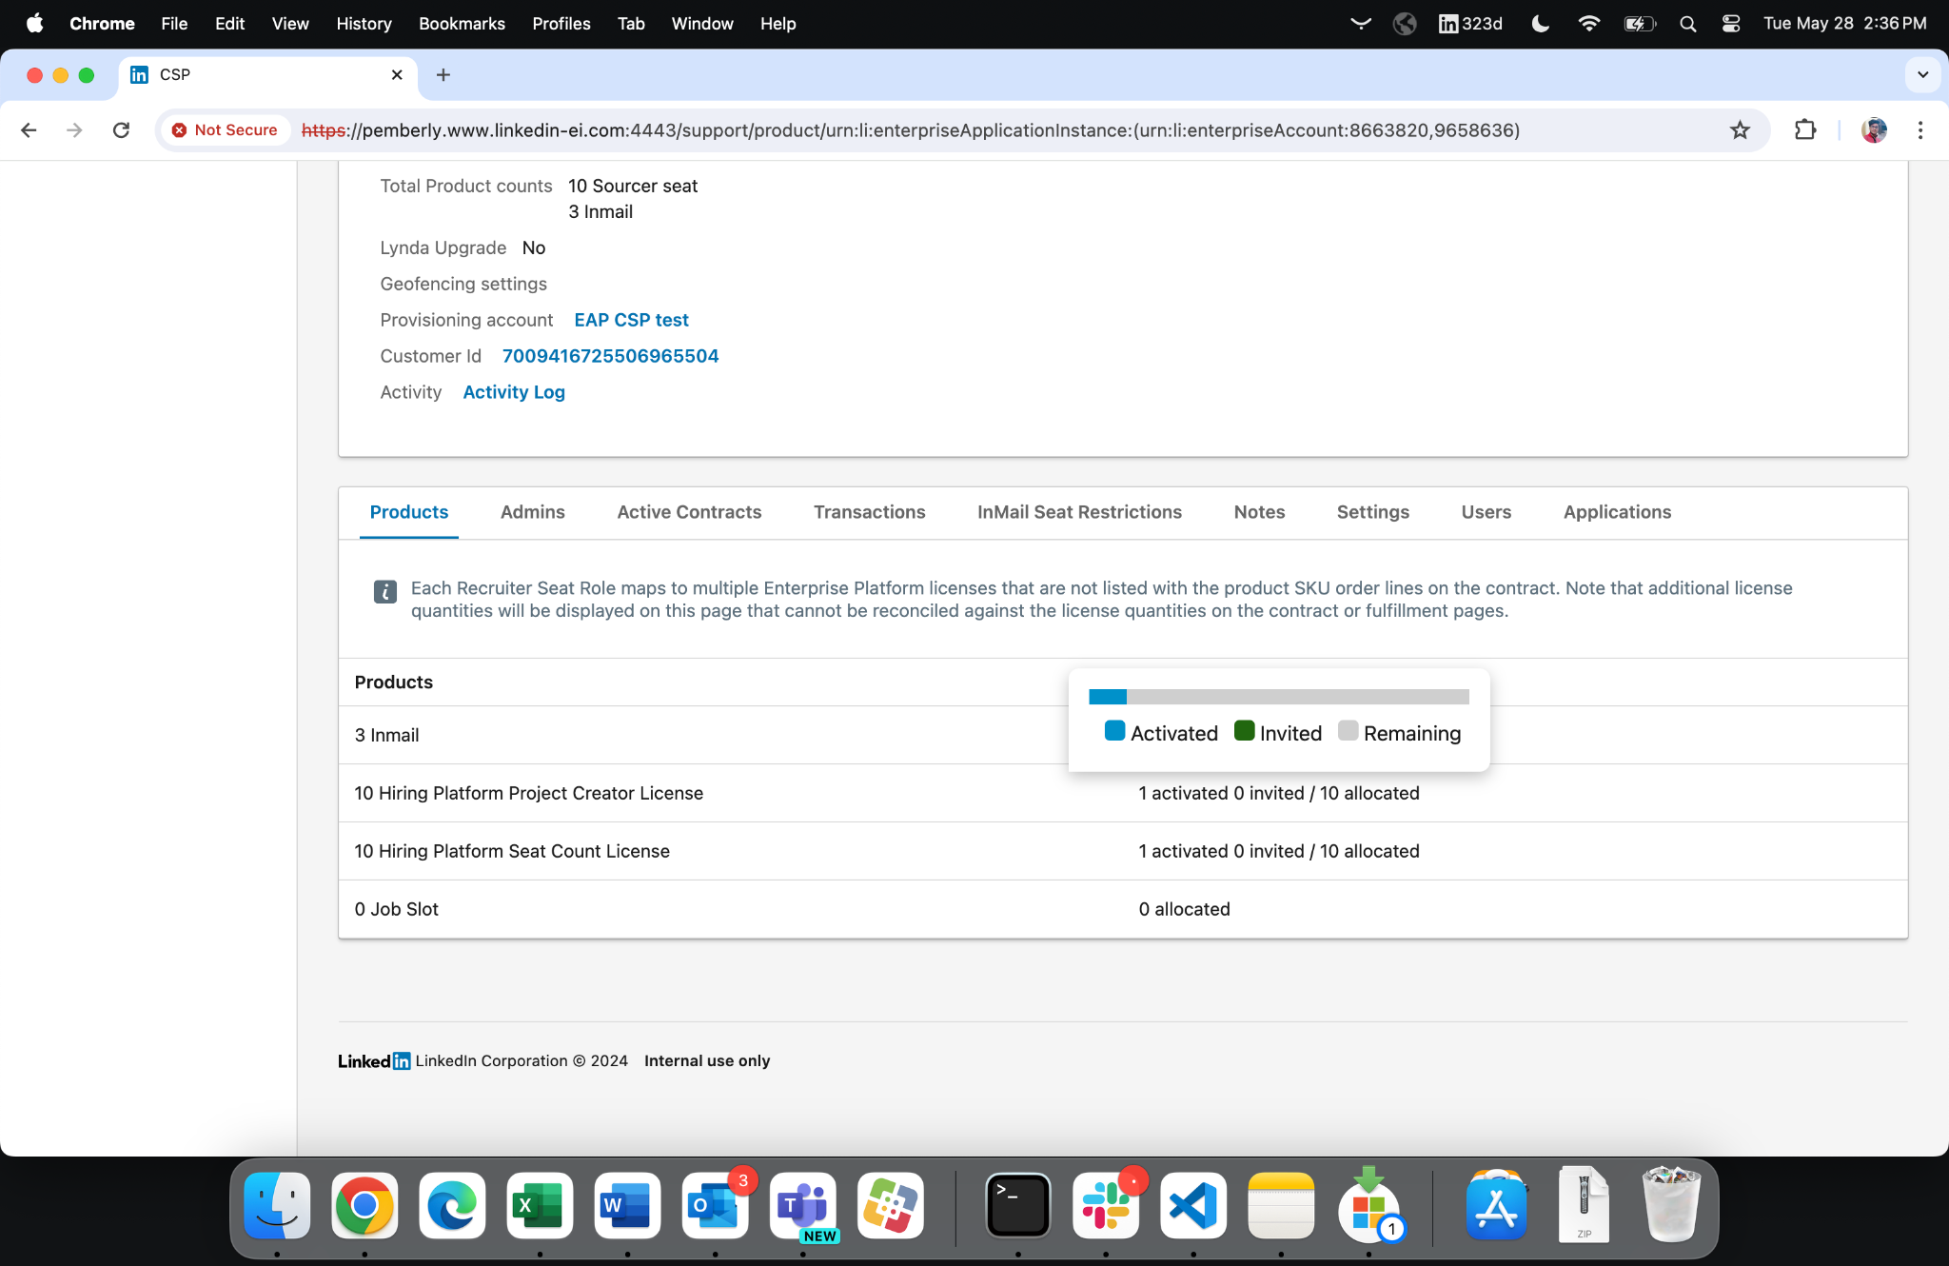
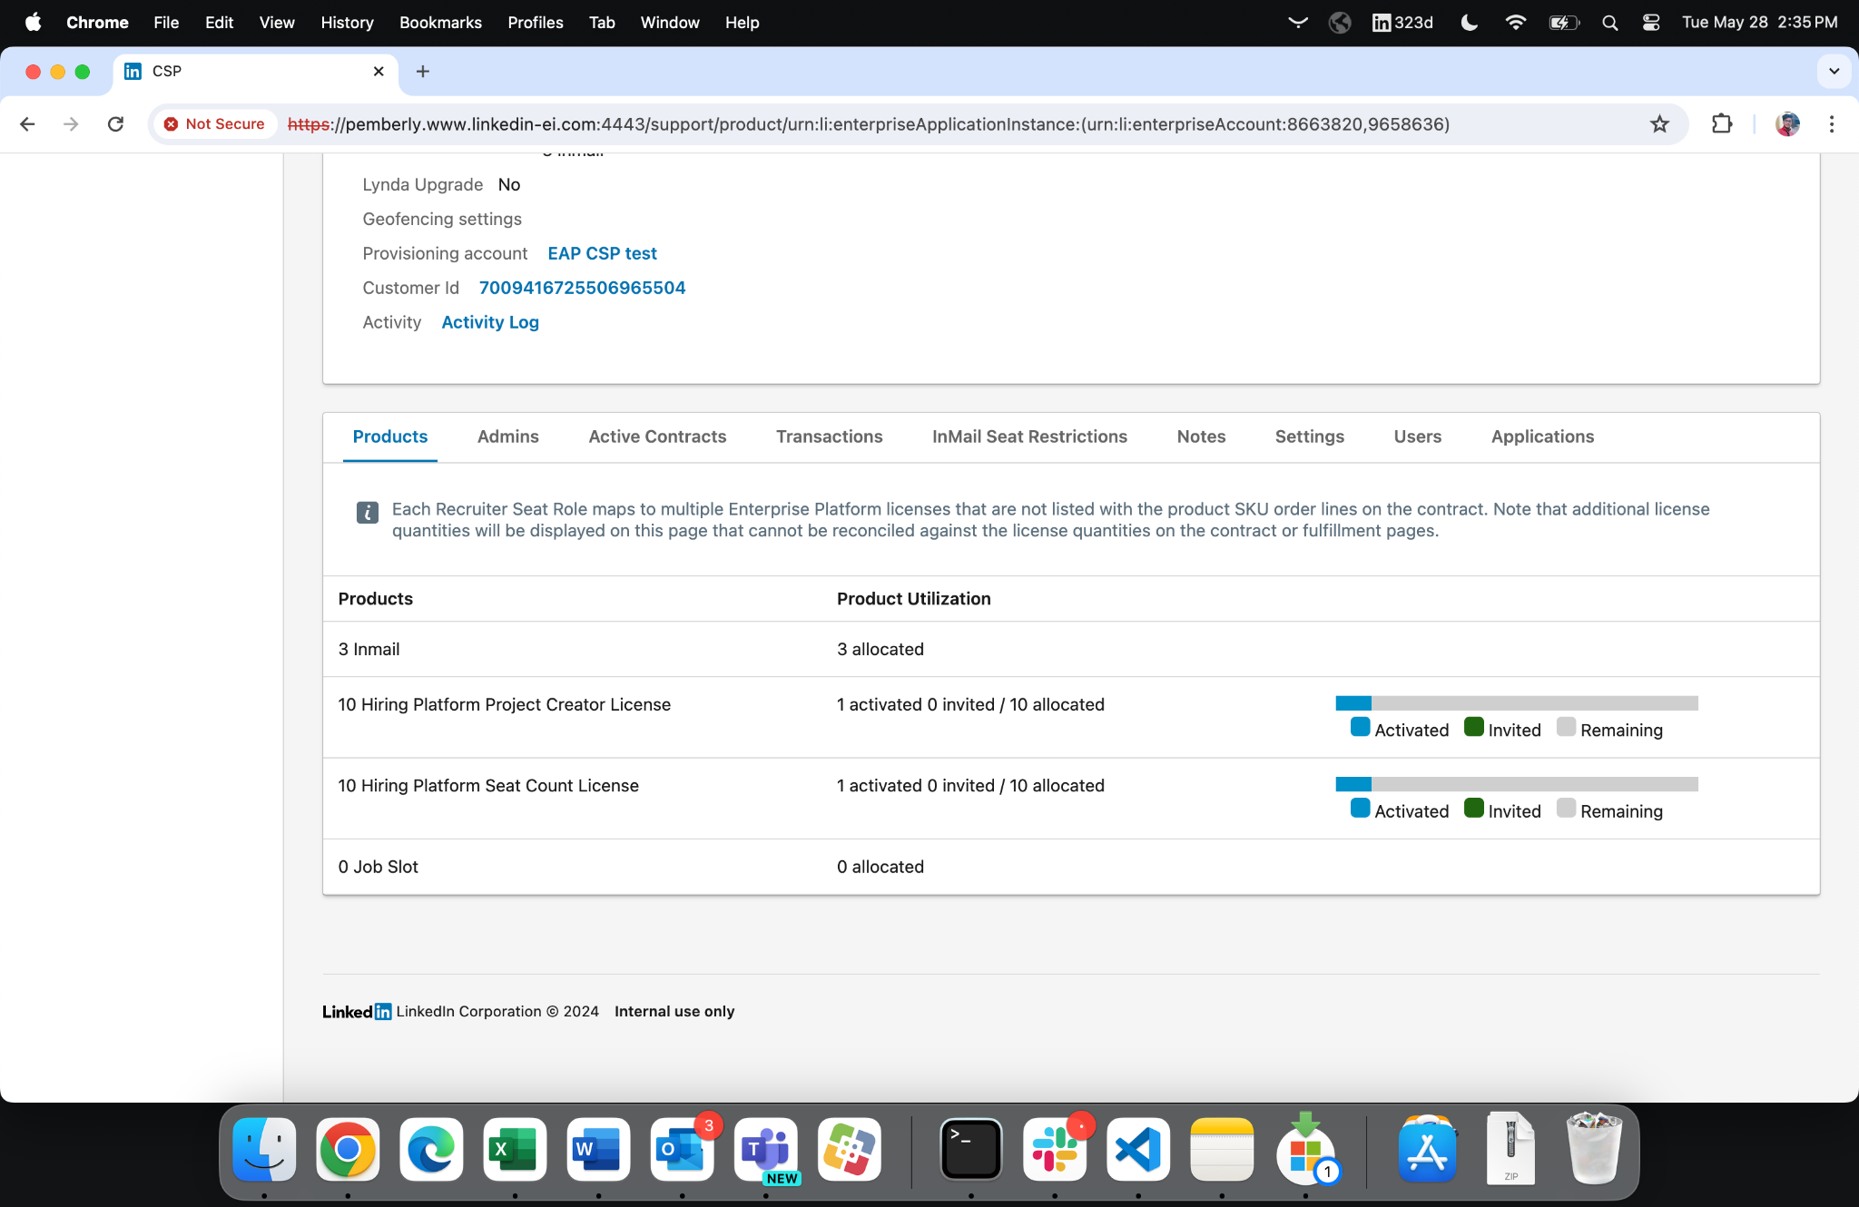
Old view
New view

Slide 7
DEMO
Example1
Example2
Example3

Slide 8
Project - Multi-Dashboard Phase 2
Problem Statement
As highlighted in the Multi-dashboard support Recruiter PRD,
One of the most requested features is the functionality of efficient allocations to multiple dashboards in fewer clicks on CSP
We need to allocate multiple product lines (potentially across multiple years) (bundling) from a Fulfillment to multiple dashboards in a single request.
Why it is Required?
Estimated that lack of this feature resulting in an 7# clicks per line to support these provisioning requests
This feature brought down the average number of clicks by factor of 3 (for a single year Recruiter opportunity) or over 9 (for a multi-year opportunity)

Slide 9
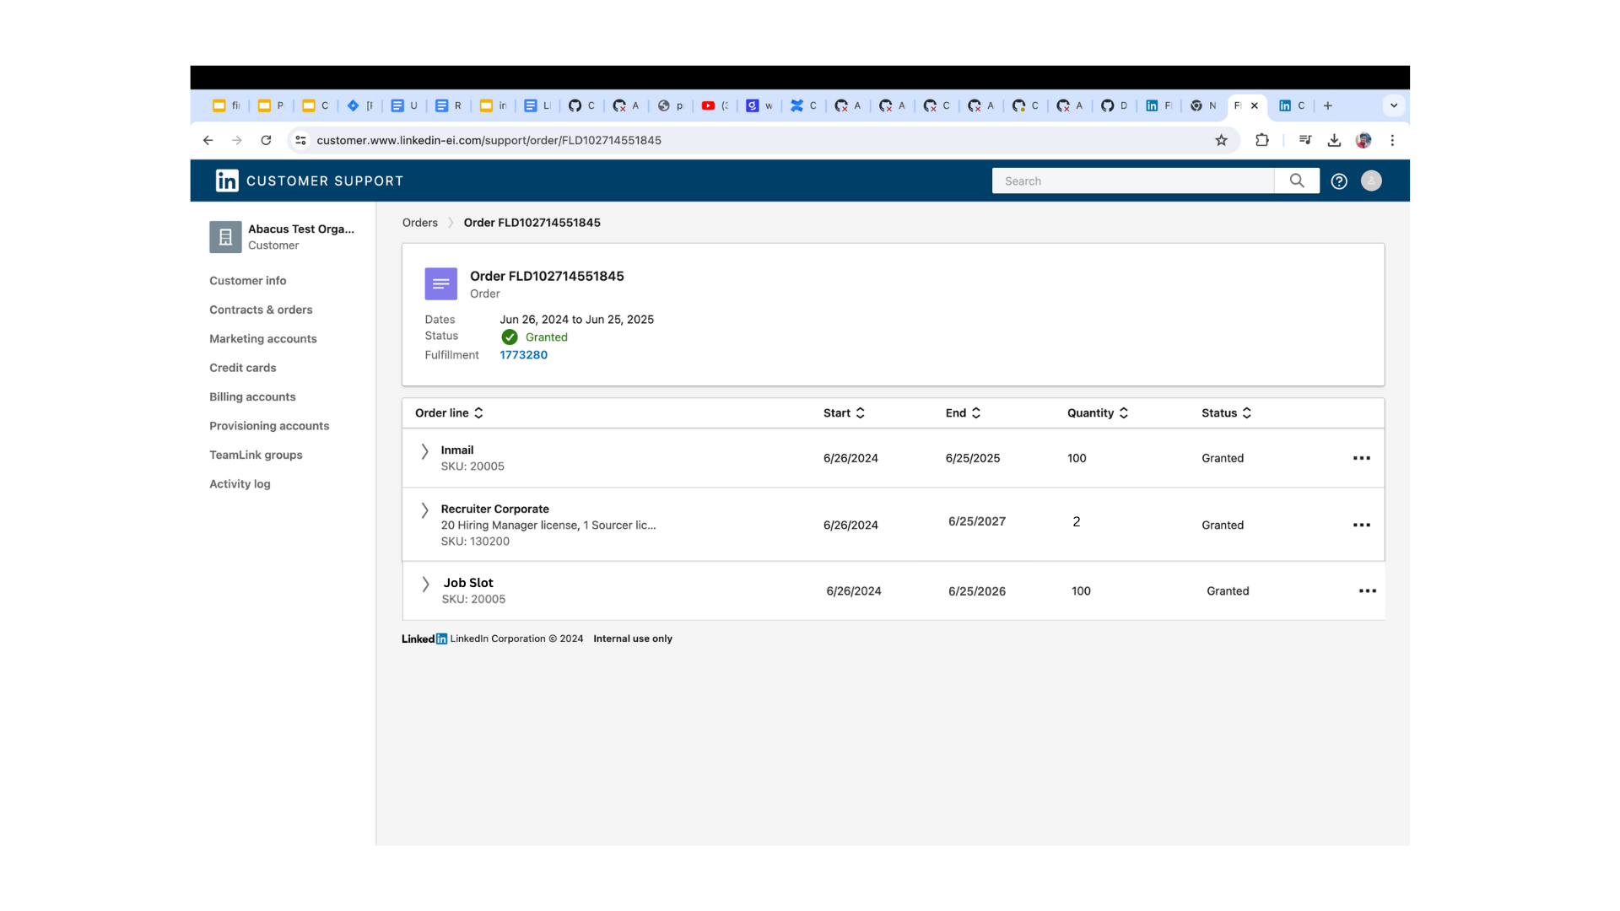
Project - Multi-Dashboard Phase 2
Order placed

Slide 10
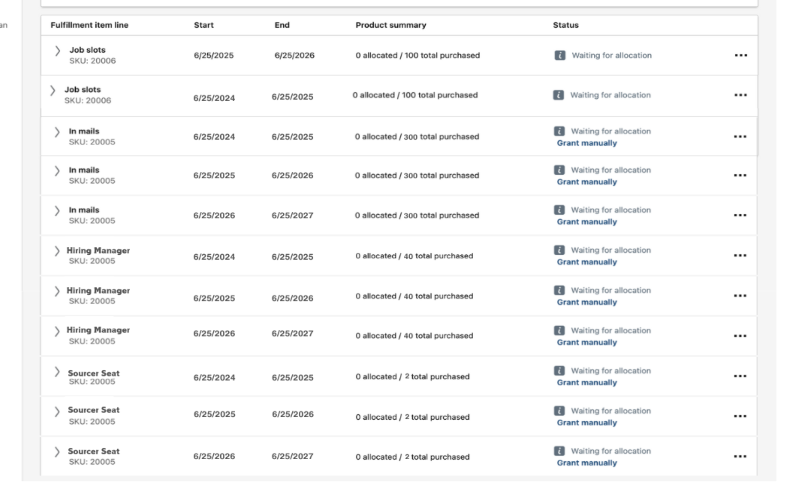
Project - Multi-Dashboard Phase 2
fulfillment page look like

Slide 11
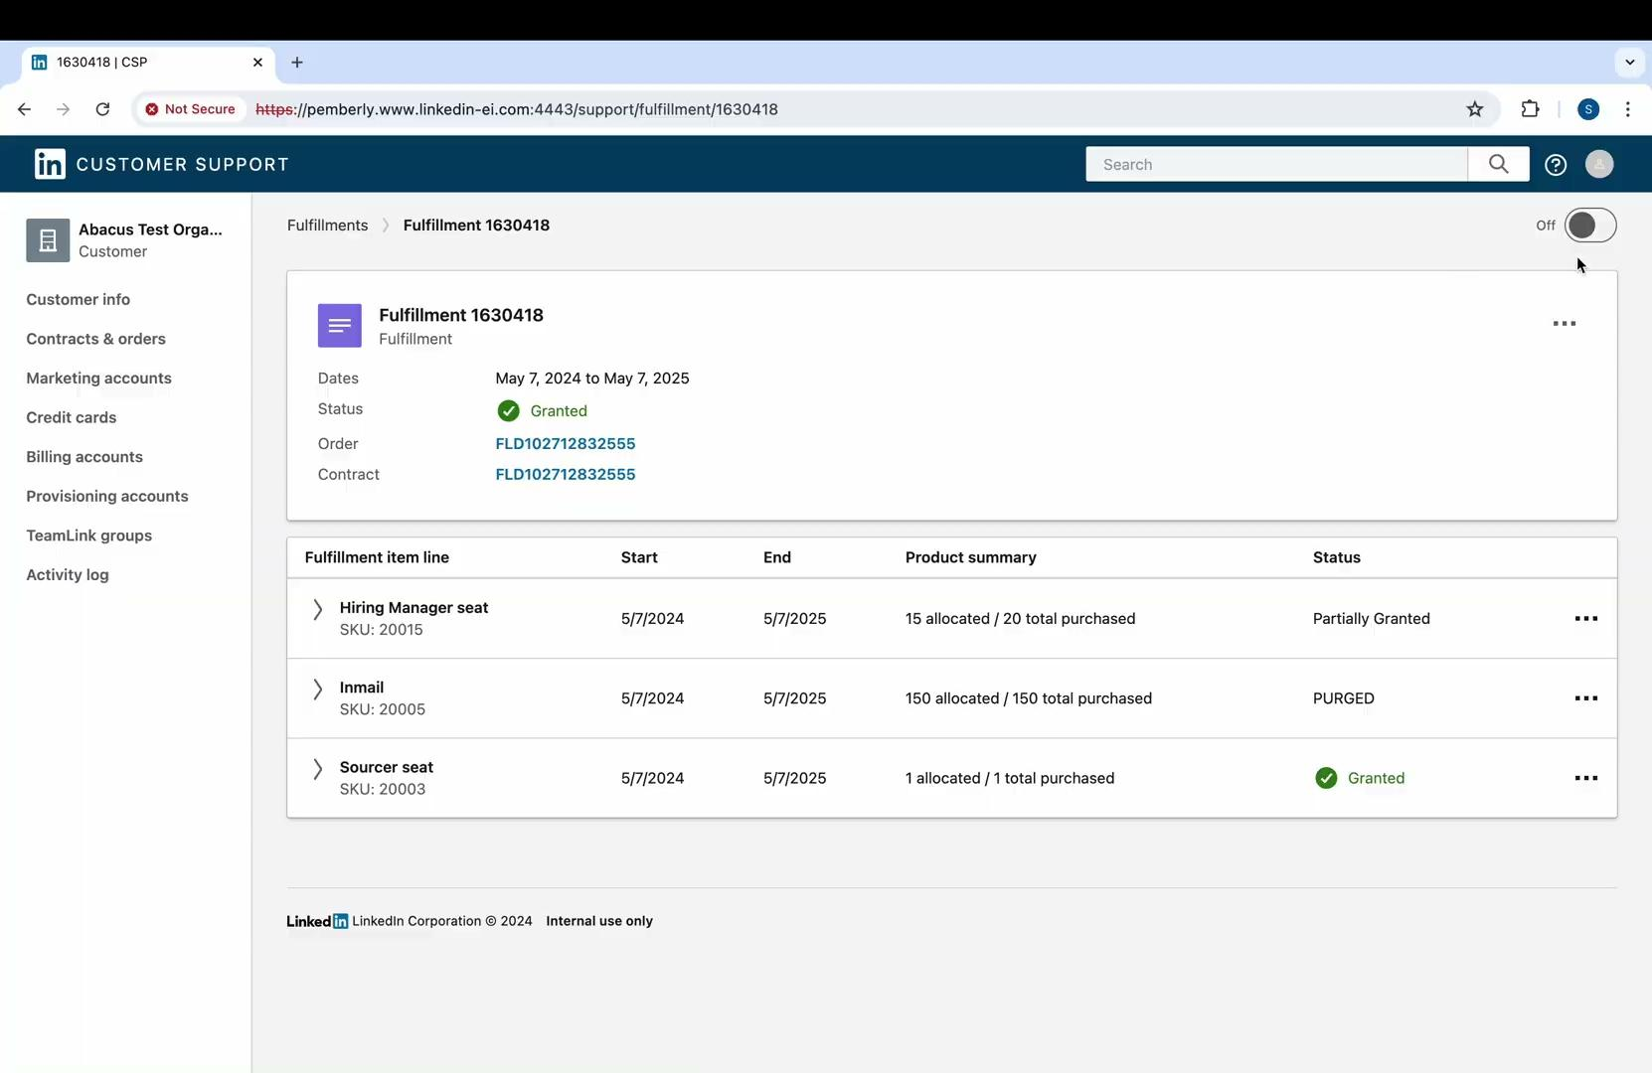
Project - Multi-Dashboard Phase 2
Solution design

Slide 12
Project - Multi-Dashboard Phase 2
Let’s there are 2 dashboards which you want to allocate to each product lines (d = 2)
Now you have 12 number of product-lines (l = 12)
On an average you required 7# clicks per lines (c= 7)
Total number of clicks for current fulfillment page = c * l * d = 168
Select those product lines (#clicks = nl)
Go to bulk manage allocation (#clicks = 1)
Select dashboards (#clicks = 3*d) **average 3 clicks per dashboard selection
Fill the UX Grid (#clicks = nl*d)
Submit (#clicks = 1)
Calculation
Total number of clicks for new fulfillment page = nl+2+nl*d+3*d = 17

Slide 13
Components
New-components added
Bulk-view-allocation: to view allocations for selected item-lines
time-period: to render time range, start date and end date of fulfillment-item-line
view-allocation-data: to render allocation summary and history details with table
view-allocation-modal: to render sidesheet with tab switching between transactions and summary
manage-actions: to render three-dot menu over fulfillment table to select actions
table-v2: recursively render table for bundled-item-lines
fulfillment-details-v2: to render new fulfillment page when toggle is ON
Changes in existing
fulfillment: to render toggle button for switching between old and new pages
description-cell: to render expand toggle and checkbox for each fulfillment-item-line

Slide 14
Migration from Artdeco to Hue
New-components added

Slide 15
Ramping Plan
Initial ramping of lix
Toggle button is present to switch between old and new fulfillment pages, new page is in read only mode
l
Stage 1
Ramp actions on new fulfillment
Ramping of actions Revoke selected and Grant selected, bulk allocation of multiple lines to multiple dashboard
Stage 2
Final ramping of lix
Ramp lix to 100% and toggle is present for all customers
Stage 3
Removal of lix
Toggle button is removed and there is only new fulfillment page
Stage 4

Slide 16
Future Aspects
1
2
3
Revoke/Grant Selected
Styling changes
Compatibility checks
Revoke and Grant action for selected-item-lines
Provisioning of multiple product-lines to multiple dashboard
On select any item-line, disabled other incompatible lines in CSP-WEB
4
5
Support bundling in API
Bulk UX allocation Grid
Add feature in CSP-API which will pass bundled item-lines to CSP-WEB
Provisioning of multiple product-lines to multiple dashboard

Slide 17
Challenges
Learnings
EmberJs, Rest APIs
Designing of LLD / RFC
Github and Git commands
Best practices for writing Production Level Code
Importance of Testing (auto, manual)
Required Tools eg: lix, jira, etc..
Reasonable size PRs
Soft Skills
Attention to detail
Collaboration and Communication
Time Management
Understanding of user-experience
Understanding the vast Codebase
Setup of MPs
Exploration of component-table which can support required feature for MDP2
Infra/Tooling Issues

Slide 18
References
Multi-dashboard Support Recruiter PRD
RFC - Bulk Allocation
LLD - Bulk Allocation (mid-tier, backend)
LLD - Bulk Allocation (frontend)
Intern progress tracker
JIRA tickets
PROV-219738
PROV-235052
PROV-234720

Slide 19
Got Questions? Would love to discuss!

